Slide 1
Day 2 – Models and Methods

Slide 2
Day 1 reminders
Deep learning overview
Few-shot learning
Explicitly train model to generalize to new classes
Few-shot in action
Image filtering
Recent trends
Practical example
Applying few-shot models to new data

Slide 3
Questions from day 1?

Slide 4
Training a Deep Learning Model

Slide 5
Large Data Paradigm
When training a typical deep learning model using a sufficiently large dataset, data is split into train, test and validation splits.
The percentage allocated to each split varies, but anything from 60/20/20 to 80/10/10 is common
Each split has an explicit purpose:
Train – Data used to update model weights.
Validation/Development – Data used to evaluate model during training and tune hyperparameters.
Test – Hold-out data, used for final evaluation values that are published.

Slide 6
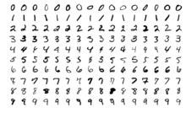
Large Data Paradigm
train
val
test
When using this three-way split, it is assumed that each split sufficiently represents the true distribution of each class
For example, the MNIST handwritten digit dataset contains the numbers 0-9 and is used to train an image classifier
http://yann.lecun.com/exdb/mnist/
A bad split would be to use digits 0-7 for training, digit 8 for validation, and digit 9 for testing
There is no hope for a model to perform inference correctly on digits 8 or 9
Instead, any reasonable researcher would use a random sample or a stratified random sample to create the test, validation, and test sets.

Slide 7
Generalizability
Generalizability is the ability of the model to perform well on unseen data points
In the large data paradigm, generalizability is constrained by the domain of the training data
Continuing with the MNIST example:
A model with good generalizability will be able to classify the digits 0-9 written in a variety of handwriting styles.
No model trained on MNIST would be able to classify letters

Slide 8
Training
https://xkcd.com/1838/

Slide 9
Training
Forward Pass: Feed an datapoint (or batch of datapoint) through the model
Loss Function: Compare the model output to the ground truth target value(s) to get the amount of error
Backpropagation and weights update: Change the weights of the model to try and decrease that error
Repeat for every example in the dataset
Once you have completed these steps for every example in your dataset, you have completed one epoch of training. Training can take dozens to thousands of epochs

Slide 10
Loss Functions
Loss functions measure the error of a model
Always produce a scalar value
Always differentiable
Is a function of the weights, biases, and training data
Regression Tasks:
Mean Squared Error
Mean Absolute Error
Classification Tasks:
Binary Cross-entropy
Categorical Cross-entropy
Regularization
L1, L2, or custom regularizing terms can be added to constrain model weights

Slide 11
Optimizers
We need an algorithm that will find the optimal values for the weights and biases that minimizes the loss function
This is a high dimensional nonlinear optimization problem. The weights of the model are the parameters of the loss function
We can use numerical methods (optimizers) to minimize the loss function to find model weights that result in low error.
https://ruder.io/optimizing-gradient-descent/

Slide 12
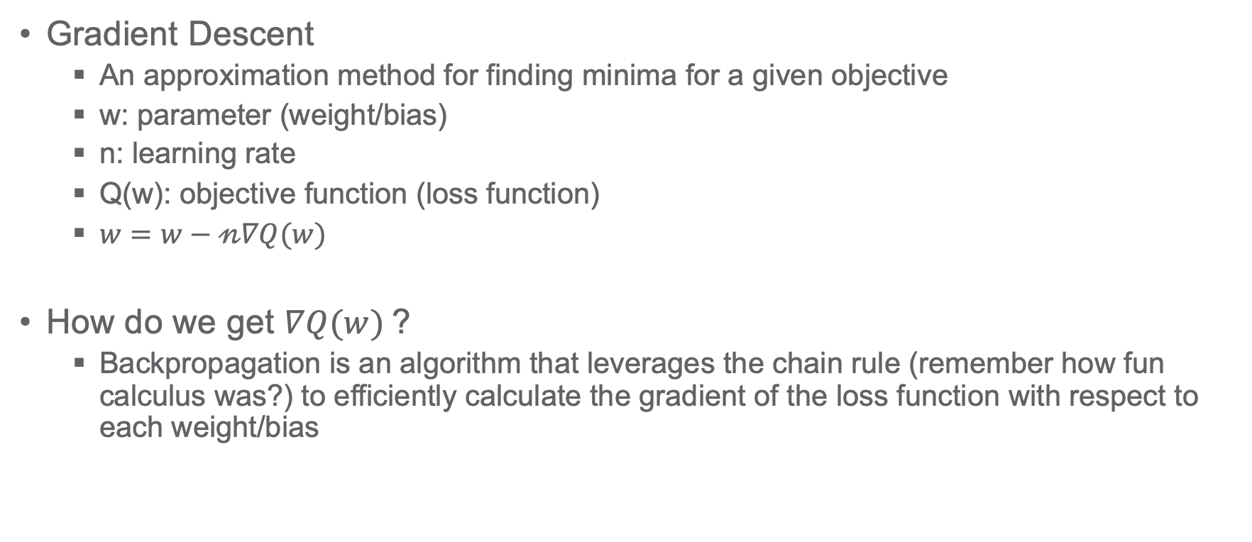
Optimizers
Gradient Descent
An approximation method for finding minima for a given objective
w: parameter (weight/bias)
n: learning rate
Q(w): objective function (loss function)
$w=w−𝓃∇Q(w)$
How do we get $∇Q(w)$?
Backpropagation is an algorithm that leverages the chain rule (remember how fun calculus was?) to efficiently calculate the gradient of the loss function with respect to each weight/bias

Slide 13
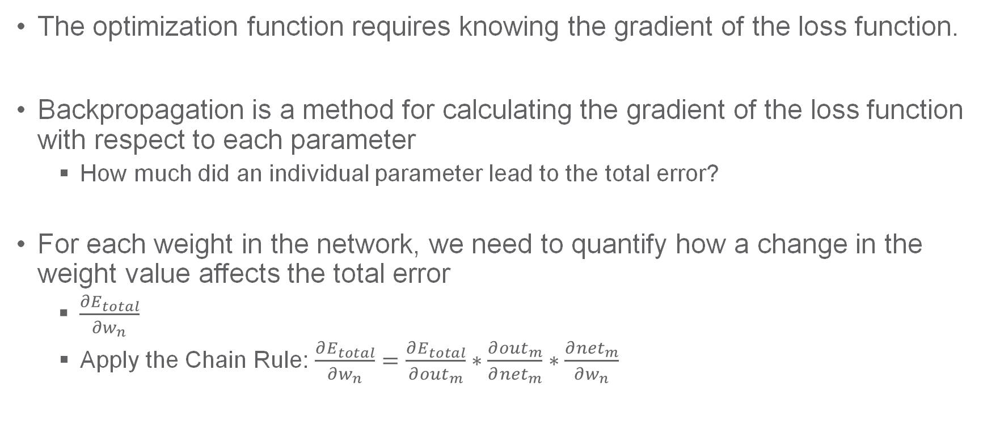
Backpropagation
The optimization function requires knowing the gradient of the loss function.
Backpropagation is a method for calculating the gradient of the loss function with respect to each parameter
How much did an individual parameter lead to the total error?
For each weight in the network, we need to quantify how a change in the weight value affects the total error
$\frac{∂E_{total}}{∂w_{n}}$
Apply the Chain Rule: $\frac{∂E_{total}}{∂w_{n}}=\frac{∂E_{total}}{∂{out}_{m}}∗\frac{∂{out}_{m}}{∂{net}_{m}}∗\frac{∂{net}_{m}}{∂w_{n}}$

Slide 14
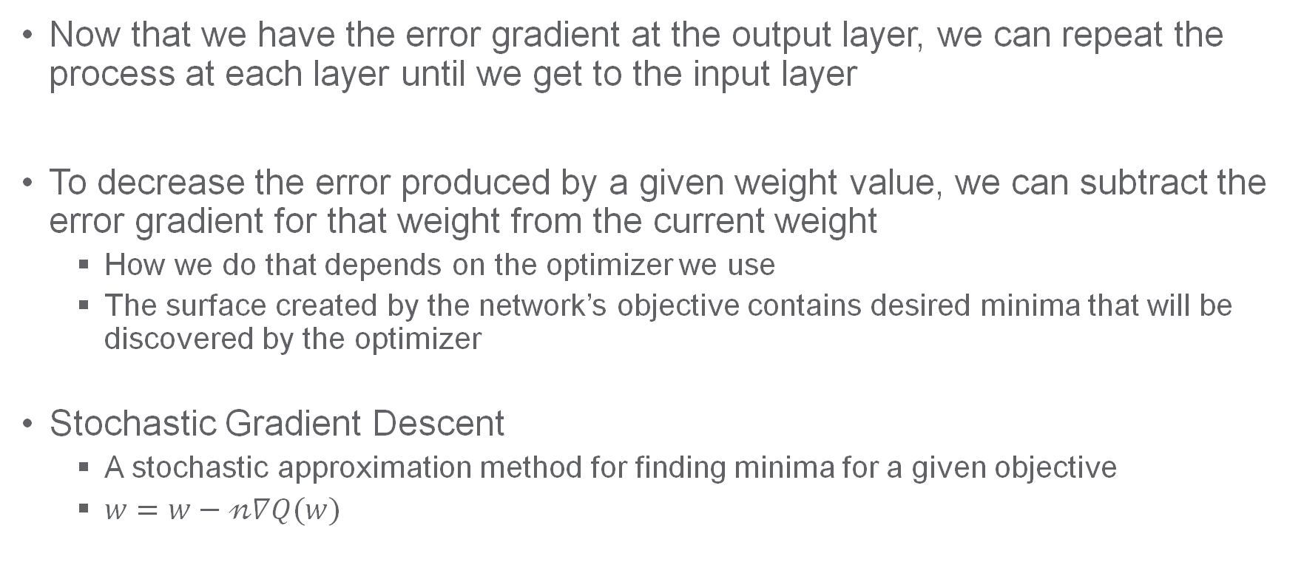
Backpropagation and Optimizers
Now that we have the error gradient at the output layer, we can repeat the process at each layer until we get to the input layer
To decrease the error produced by a given weight value, we can subtract the error gradient for that weight from the current weight
How we do that depends on the optimizer we use
The surface created by the network’s objective contains desired minima that will be discovered by the optimizer
Stochastic Gradient Descent
A stochastic approximation method for finding minima for a given objective
$w=w−𝓃∇Q(w)$

Slide 15
Mini-batches
Mini-batches
We usually don’t calculate the loss for each example individually
Mini-batch loss is usually a simple average of the loss of each example in the batch
Instead, a mini-batch (often just called a batch) is used to:
Reduce computation time by parallelizing the feed forward and backpropagation steps
Explore the loss landscape in an efficient way
Each mini-batch can be randomly sampled from the training data or stratified sampling can be used to control the influence of different types of data

Slide 16
Learning Rate
Optimizers use a learning rate parameter to dictate how big of an update to make to the weights at each step
Too high learning rates cause the model training to diverge
Too low of learning rates produce slow model training that may not explore enough of the loss landscape
https://cs231n.github.io/neural-networks-3

Slide 17
Training a Few-shot Deep Learning Model

Slide 18
Datasets
Few-shot learning needs to generalize to unseen classes instead of unseen datapoints. This fundamentally changes how we approach splitting our data.
Recall:
Train – Data used to update model weights.
Validation – Data used to evaluate model during training and tune hyperparameters.
Test – Hold-out data, used for final evaluation values that actually get published
But now we split on the classes instead of the datapoints so each split contains entirely unique classes.

Slide 19
Datasets
Big data setting
Few-shot setting
train
val
test
train
val
test
http://yann.lecun.com/exdb/mnist/
http://yann.lecun.com/exdb/mnist/

Slide 20
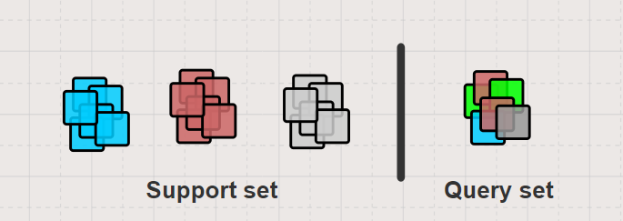
Episodes
Recall the structure of our problem from day 1:

Slide 21
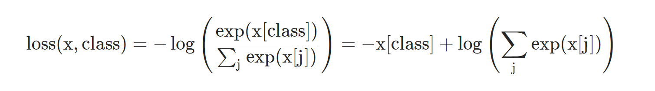
Loss Functions
Most few-shot problems are classification problems, so we naturally lean heavily on the classic cross-entropy loss function:
We want the model to learn how to classify arbitrary classes in the support set, not particular classes in the training data so we relabel our datapoints according to their class order in the support set.

Slide 22
Episodes
In order to take advantage of big datasets
Sample whole episode from dataset
Run episode through the model and compute the loss
Compute gradients via backpropagation
Update model weights
Note that under this setup we are sampling new classes in each episode

Slide 23
Meta-batches
Some few-shot learning approaches apply meta-batching to the training process, sampling many episodes at a time instead of just one
Because of the stochasticity of random sampling, gradient updates may vary considerably from episode to episode. Averaging over multiple batches smooths this
Instead of

Slide 24
Training
Forward Pass: Feed an episode (or batch of episodes) through the model
Loss Function: Compare the model output to the ground truth target value(s) to get the amount of error
Backpropagation and weights update: Change the weights of the model to try and decrease that error
Repeat for a fixed number of episodes
Once you have completed these steps for some fixed number of episodes, you have completed one iteration of training. Training can take dozens to thousands of iterations

Slide 25
Tips and Tricks
Learning rates are very important
Because episodes change stochastically, there may be large gradient differences episode-to-episode
Small learning rates & using meta-batches help to smooth gradient updates
Training encoders from scratch seems to be difficult
Significantly better performance starting with a pretrained encoder
Can make the difference between completely untrainable and state-of-the-art performance
When training on large datasets, it can take a long time to start overfitting
If it isn’t obviously overfitting, training longer might help

Slide 26
Few-shot Models & Algorithms

Slide 27
Few-shot Models
Metric Learning
Metric learning models attempt to learn a mapping from the dataset into a metric space where proximity implies similarity.
Meta-Learning
Meta-learning models explicitly optimize to find parameters that can be easily fine-tuned on the support set
Conditioning Models
Conditioning models attempt to modify the encoder at evaluation time to better adapt to the particular support set.
Notes:
Sort models based on core ideas and model structure
Metric learning
ProtoNets
RCNet
Meta-learning
MAML
FOMAML
Reptile
LEO
Conditioning models
TADAM
FEAT
SCNAPS
Focus less on the technical details of each model and more on the limitations and strengths of each model

Slide 28
Metric Learning - Prototypical Networks
Since data is limited, our model probably needs a very simple inductive bias. (Snell et al. 2017)
With so few samples per class, nearest-neighbor classification might be too noisy.
Represent data as points in embedded space
Each class gets a “prototype” that is average of its members
New data grouped based on distance to prototypes
No longer state of the art, but it's a very common few-shot baseline.
Simple to implement and straightforward to train.
Notes:
Snell, Jake, Kevin Swersky, and Richard Zemel. "Prototypical networks for few-shot learning." Advances in neural information processing systems. 2017.

Slide 29
Metric Learning - Relating and Comparing Networks (RCNet)
Prototypical networks has limited flexibility. Only one way to compare classes
Solution: Allow model to learn how to compare
Class prototypes based on pairwise relations between support examples
Query examples are compared to class prototypes, conditioning the class representation
MLP to predict classes instead of Euclidean distance
Performs similarly to prototypical networks, but more flexible.
Can incorporate corrective user feedback and classify "none of the above" queries.
Notes:
Hilliard, Nathan, et al. "Few-shot learning with metric-agnostic conditional embeddings." arXiv preprint arXiv:1802.04376 (2018).

Slide 30
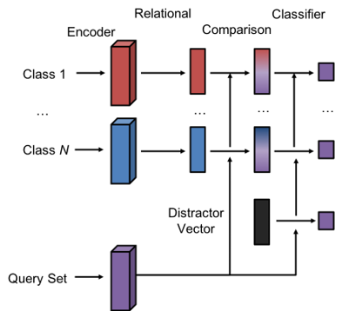
Metric Learning - RCNet
Relational stage creates a class representation
Relates datapoints within a class
Comparison stage allows queries to condition the class representation
“Distractor” vector represents a none-of-the-above option for images that belong to no class

Slide 31
Metric Learning
ProtoNets distance calculation enforces a strong inductive bias that is useful for few-shot problems
Many non-metric based approaches draw inspiration from this
RCNet allows the model to learn how to perform comparisons
Flexibility to support none-of-the-above
Integration into a user interface allows for user feedback through “negative” examples
Metric-based models typically require zero gradient updates during inference making them computationally efficient

Slide 32
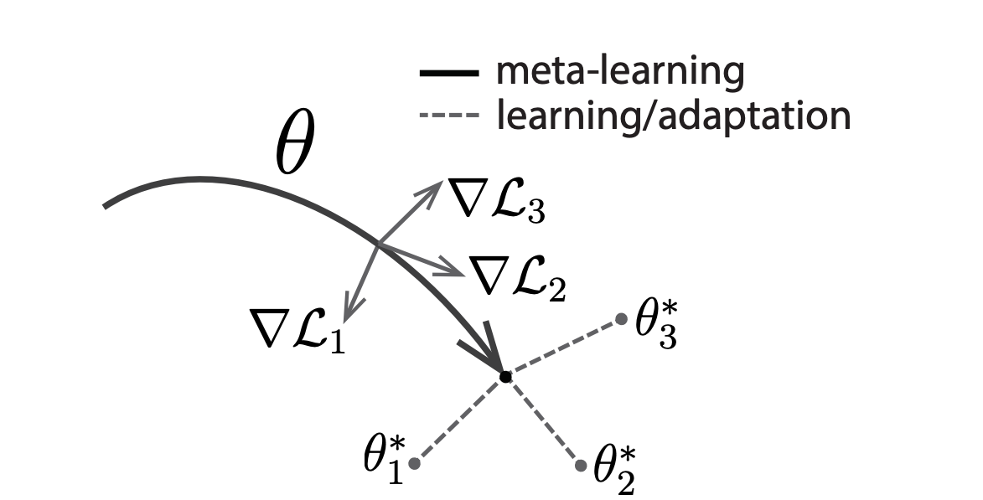
Meta-Learning – MAML
It might not be reasonable for one set of parameters to solve every problem.
What if we "learned to learn", so we could adapt a model to new data quickly?
Solution: Meta-optimization! (Finn et al., 2017)
Starting from our initial weights θ, update using a few steps of gradient descent
Repeat over a few episodes to get θ* for each episode
Find a value for θ such that gradient descent would have found better θ* values
Gradient descent over gradient descent
Influential idea, but computationally inefficient
REPTILE, FOMAML, and many other variants
Can be applied to non-few-shot problems as well (e.g. Reinforcement learning)
https://arxiv.org/abs/1703.03400
Notes:
Finn, Chelsea, Pieter Abbeel, and Sergey Levine. "Model-agnostic meta-learning for fast adaptation of deep networks." arXiv preprint arXiv:1703.03400 (2017).

Slide 33
Meta-Learning - LEO
MAML's nested gradient optimization gets expensive quickly.
It becomes prohibitive to train on more than a few episodes in parallel.
Especially true when optimizing over our model's full parameter space.
Solution: Learn to generate model parameters from embedded data!
Three components: datapoint encoder, relational network, and parameter decoder.
The "inner loop" only optimizes the episode's latent vector.
The "outer loop" optimizes all three components to adapt quickly.
Outperforms MAML by 10+ accuracy points!
One of the top-performing methods compared against today.
Notes:
Rusu, Andrei A., et al. "Meta-learning with latent embedding optimization." arXiv preprint arXiv:1807.05960 (2018).

Slide 34
Meta Learning
MAML and other some of its variants are among highest performers on many standard academic datasets
Although note that these are mostly small image datasets (84x84 pixels), so it’s unclear whether this result scales to larger datasets
Very flexible approach that is also useful for non-few-shot tasks
Difficulties
Computational efficiency
Requires gradient steps during inference
Performs poorly as data begins to differ from training classes
Although incorporating aspects of ProtoNets reverses this (Triantafillou et al., 2019)
Notes:
https://arxiv.org/abs/1903.03096 META-DATASET: A DATASET OF DATASETS FOR LEARNING TO LEARN FROM FEW EXAMPLES

Slide 35
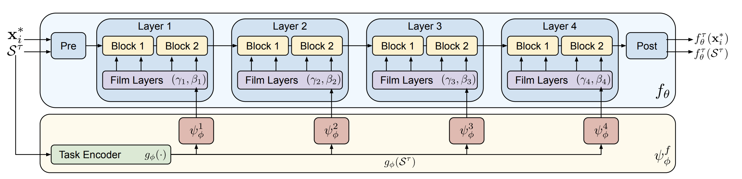
Conditioning Models – CNAPS / SCNAPS
Meta-optimization adapts to unseen tasks, but is computationally expensive
Solution: Train model to adapt its own parameters
Use the support set to “condition” the encoder, modifying how the encoder processes query datapoints (CNAPS:Requeima et al. 2019; SCNAPS: Bateni et al., 2020)
FiLM conditioning (Perez et al. 2017)
Less computationally expensive, shows good generalization performance
FiLM conditioning structure. From fig 3: https://arxiv.org/pdf/1912.03432.pdf
Notes:
Requeima, James, et al. "Fast and flexible multi-task classification using conditional neural adaptive processes." Advances in Neural Information Processing Systems. 2019.

Slide 36
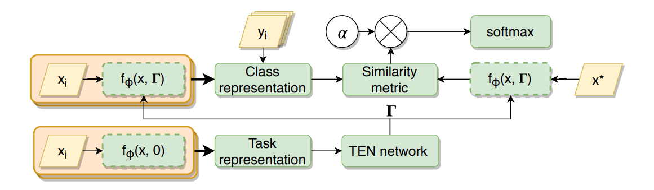
Conditioning Models - TADAM
Early conditioning model, similar to SCNAPS.
Incorporates conditioning into a Protonets-like model (Oreshkin et al., 2018)
Outperforms prototypical networks by 9+ accuracy points!
Still outperformed by other conditioning methods, today.
http://papers.nips.cc/paper/7352-tadam-task-dependent-adaptive-metric-for-improved-few-shot-learning
Notes:
Oreshkin, Boris, Pau Rodríguez López, and Alexandre Lacoste. "Tadam: Task dependent adaptive metric for improved few-shot learning." Advances in Neural Information Processing Systems. 2018.

Slide 37
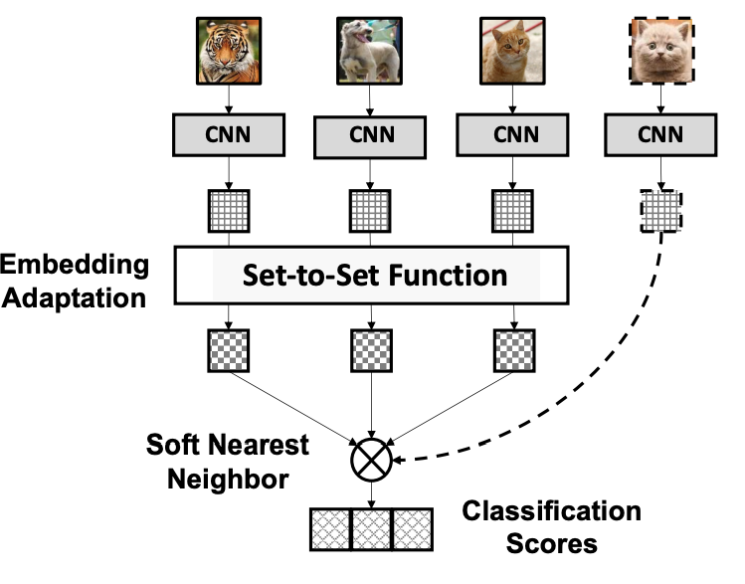
Conditioning Models - FEAT
Previous methods run through the data twice
Once to determine conditioning, then to apply it
TADAM has to run the full encoder twice. SCNAPS uses a smaller "task network"
Solution: Co-adapt all support features after encoding!
Uses a transformer as an efficient set-to-set function.
Competitive with other recent approaches.
Transformer provides additional flexibility in model design
http://openaccess.thecvf.com/content_CVPR_2020/html/Ye_Few-Shot_Learning_via_Embedding_Adaptation_With_Set-to-Set_Functions_CVPR_2020_paper.html
Notes:
Ye, Han-Jia, et al. "Few-shot learning via embedding adaptation with set-to-set functions." Proceedings of the IEEE/CVF Conference on Computer Vision and Pattern Recognition. 2020.

Slide 38
Conditioning Models
Conditioning has been a strong approach for improving metric-based model performance
Best performers still seem to rely on strong ProtoNets-like inductive biases
Lots of active research in this area
No systematic comparison yet
Faster inference
Finetune
MAML
all
Classifier & Feature adapter
TADAM
Model flexibility
# Params to Adapt
SCNAPS
FEAT
RCNet
Classifier only
Proto-MAML
ProtoNet
Multi-step gradient
Few-step gradient
Fixed function
Adaptation mechanism

Slide 39
Model Evaluation

Slide 40
Comparing Models
Many different competing approaches to few-shot learning
Including some different alternatives we’ll touch on Day 4
Direct comparison of models is difficult to assess from academic literature for a variety of reasons…
Implementational details
How are classes/datapoints sampled for training?
Are you allowed to use the full test set to make individual predictions (i.e. transductive learning?)
Data splits are sometimes vague

Slide 41
MiniImageNet
As an example, 5-shot, 5-way performance on MiniImageNet is the most reported performance metric in the academic literature
There are two train/test splits in common usage…
Is fine-tuning a good approach?
Maybe, but it also uses a bigger encoder…
All of these models are trained on 84x84 pixel images
Not useful for real-world tasks
 | 5-shot, 5-way | Encoder | Transductive?
MatchingNets | 60.0 | Conv (64)x4 | No
ProtoNets | 68.2 | Conv (64)x4 | No
MAML | 63.1 | Conv (32)x4 | Yes*
R2D2 | 68.4 | Conv (96)x4 | No
TADAM | 76.7 | Resnet-12 | No
Fine-tuning | 78.2 | WRN-28-10 | No
Transductive fine-tuning | 78.4 | WRN-28-10 | Yes
LEO | 77.6 | WRN-28-10 | Yes?
Not stated in paper
Results as reported in https://arxiv.org/pdf/1909.02729.pdf

Slide 42
Model Take-aways
Most results are on small models trained on small images
Metric-based and conditioning approaches seem well-suited to scaling up
Meta-learning is a strong approach, but hasn’t been tested on many large problems
Inductive biases, e.g. fixed distance functions for classification, seem strong
ProtoNets, ProtoMAML, SCNAPS all perform well even when generalizing to new datasets
As in other areas of deep learning, the field moves quickly
Expect to see new innovations

